Slide 1
CST8201
Operating System Fundamentals
PC Hardware

Slide 2
Lecture Plan
Classes of Computers
An Informative Video
Core Components
Secondary Storage
The Boot Process

Slide 3
Classes of Computers
Computers can be classed in many different ways – my classification is as follows:
  Supercomputers
  Mainframes
  Minicomputers
  Microcomputers
  Smartphones

Slide 4
Supercomputers
Purpose
  Maximize processing capacity
  Used for solving problems in:
    Quantum mechanics
    Climate research
    Molecular modeling
    etc...
Typically one-of-a-kind custom designs
Almost all run Linux
Almost all microprocessor-based
Example: iDataPlex
  7,500 Intel Xeon 2.53Ghz CPUs
  5 petabytes of storage
  Water-cooled
iDataPlex supercomputer @ U of T
(16th fastest in the world)

Slide 5
Mainframes (or “Big Iron”)
Purpose
  Very high reliability & throughput
  Strict backwards-compatibility
  Can be serviced & upgraded without being turned off (can run for decades)
  Used for bulk data-processing:
    Census
    Statistics
    Financial transactions
    etc...
Almost exclusively IBM System/360 compatible systems
Example: IBM System z10
  17 to 77 four-core CPUs
  16 to 2656 GB of RAM
  CPUs are specialized and each performs a different function

Slide 6
Minicomputers
Purpose
  Inexpensive, multi-user computer
Also known as
mid-range computers
Extinct!
  They have been replaced by microprocessor-based servers
Example: PDP-7
  Introduced in 1965
  A mere $72,000 (USD)
  4K RAM
  18-bit CPU

Slide 7
Microcomputer (or “computer”)
Has a microprocessor
  CPU functions are integrated onto a single chip
Purpose
  Physically small
  Usually single-user, can be multi-user
  Microcomputer architecture is dominant for all computing purposes today
Example: Your computer.

Slide 8
Smartphones
A mobile phone with advanced, microcomputer-like abilities
Purpose:
  Email
  Internet-access
  Etc...
May already be the most common form of computer in existance
Example: iPhone 3GS
  600mhz CPU
  256 MB RAM
  32 GB storage

Slide 9
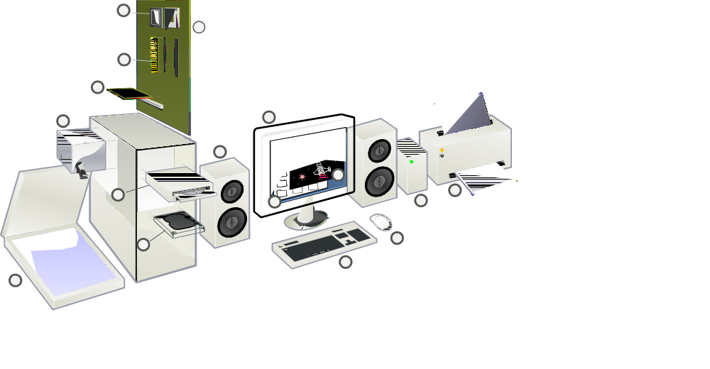
Hardware Components

Slide 10
Case
Houses and protects main electronic components
Form factor: size and configuration of case
  ATX – most common
  microATX – 25% smaller
  Laptop/notebook – non-standard

Slide 11
Power Supply
Transforms 110-volt AC current to DC current for PC
Provides clean power feed to PC components
Power supplies have standardized plugs
Low-quality or underpowered power supplies cause problems

Slide 12
Cooling Systems
Consequences of poor heat dissipation
  Mysterious system crashes
  Premature failure of computer components
Fans circulating air dissipate heat within the case
Special considerations for microprocessor
  Uses an attached heatsink and fan to dissipate heat
  Other methods, like liquid cooling, are possible

Slide 13
Motherboard
Also known as system boards
Main components of the motherboard
  Processor socket
  Memory slots
  Hard drive connectors
  Power connectors
  Expansion slots
  I/O ports

Slide 14
Input/Output Ports
Also called I/O ports
Two types of legacy ports
  Serial: used for modems, digitizer tablets, others
  Parallel: used for printers
USB ports are replacing serial and parallel ports
Connectors are identified by gender
  Male connector: copper pins exposed; e.g., serial
  Female connector: holes are present; e.g., parallel

Slide 15
Expansion Cards
Printed circuit boards inserted into motherboard
Sometimes referred to as adapters or cards
The term “adapter” usually refers to controllers
  Display adapters (video cards)
  SCSI (small computer system interface) adapters

Slide 16
Storage Devices
Non-volatile storage for data
Also known as “secondary storage”
Types of non-volatile storage:
  Floppy disks: portable, inexpensive, slow, low capacity
  Hard drives: fast, high capacity, expensive
  Optical drives: encode data with lasers, high capacity
  Tape drives: slow, high capacity, sequential access
  USB drives: portable, use flash or external hard drives

Slide 17
Communication Devices
Support data transmission between PCs or devices
Modem (modulator-demodulator)
  Phone: converts between analog and digital signals
  Cable: supports high-speed broadband transmission
Network interface card (NIC)
  Expansion board interfacing computer with local area network
  May be an expansion card that plugs into bus
  May be an interface on the motherboard
Wireless Adapters
  Provides wireless (radio) connection to LAN
  Forms: part of motherboard, PC card, USB adapter

Slide 18
Peripherals
External to the PC
Common peripheral devices
  Keyboards
  Pointing devices
  CRT/LCD monitors
  Printers
  External disk drives

Slide 19
Core PC Components
Plug into, or are part of, the motherboard
  Microprocessor
  Bus
  Memory
  Firmware
  Disk Drive Controllers

Slide 20
Microprocessor
Also called CPU (central processing unit)
Tasks performed by the microprocessor
  Arithmetic; e.g., adding and subtracting
  Logic operations; e. g, comparing two numbers
  Transferring numbers between registers
Register: small amount of high-speed memory
  A form of primary storage

Slide 21
Memory
Electronic holding area for programs and data (primary storage)
Several types of memory used in your PC
  RAM (random access memory) is read-and-write memory (volatile)
  ROM (read-only memory) contains instructions or data (nonvolatile)
  PROM (programmable read-only memory) stores a program
  EPROM (erasable PROM) may be erased with ultraviolet light
  EEPROM (electrically erasable PROM) may be erased with electricity

Slide 22
Bus
Sets of circuits on the motherboard
Responsible for transferring data between components
Expansion bus: links adapter boards to CPU and memory
All buses consist of two parts:
  Data bus: transfers actual data
  Address bus: transfers location information for data
Size of a bus (width) determines data throughput
  Example: 32-bit bus transmits 32 bits of data

Slide 23
Disk Drive Controllers
Manage data transfer between the bus and disk drive
Standard controller architectures: ATA, SATA, SCSI
Adding new disk drives
  New controllers may need to be added
  New controller should conform to existing architecture

Slide 24
BIOS
BIOS (basic input/output system)
  Supports PC during start-up
  Has functions to control keyboard, output text, reads from disk drives
BIOS may be recorded on ROM or EEPROM

Slide 25
BIOS (continued)
Option to enter BIOS setup program when PC starts
  Check the screen to see which key you should press (often DELETE or F1)
You can make configuration changes in the setup program

Slide 26
Non-Edible Secondary Storage
Floppy disks
  portable, inexpensive, slow, low capacity
Hard drives
  fast, high capacity, expensive
Optical drives
  encode data with lasers, high capacity
Tape drives
  slow, high capacity, sequential access
USB drives
  portable, use flash or external hard drives

Slide 27
Floppy Disks
Soft (floppy) magnetic disks
Key features: portability, very low capacity, low expense
Obsolete – new computers do not include floppy drives
How floppy disks store data
  Writing data: change magnetic polarization of disk
    Polarization changes translate to binary 1 and 0
  Reading data: read written information in reverse
    Magnetic fields change electric field in read head

Slide 28
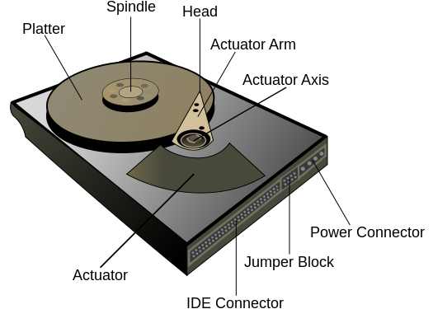
Hard Drives
Cabled to various controllers: PATA, SATA, SCSI
May be connected externally to USB, Firewire, or eSATA ports
Typical configuration of a hard drive
  Rigid rotating platters
  Spindle on which platters run at constant speed
  Read/write heads moving on a common armature

Slide 29
ATA Controllers (Parallel)
Advanced Technology Attachment (ATA)
  Integrates controller on disk drive itself
  Transfers data up to 133 MB/sec
  Also known as Parallel ATA (PATA) or Integrated Drive Electronics (IDE)
Older motherboards have two IDE connectors (primary and secondary)
  Two drives supported by each: master and slave
  Example: one connector can support one hard drive and one CD-ROM
  No longer present on modern motherboards

Slide 30
SATA Controllers (Serial)
Serial Advanced Technology Attachment (SATA)
  Transfers data at 300 MB/s or faster
  Each drive has an independent bus, so there is no competition between drives for bandwidth
  Cables are more flexible, thinner, and smaller
  Standard also specifies a new power connector
Modern motherboards typically have two or more SATA connectors
  Sometimes computers are also equipped with eSATA (External SATA) ports

Slide 31
SCSI Controller
Small computer system interface controller
Parallel interface used to attach peripherals to PCs
Can interface with up to 15 peripheral devices
Speeds may exceed speeds of SATA controllers
Be aware of multiple variations of SCSI standard
  Two SCSI devices may be incompatible
  Example: several types of connectors are supported

Slide 32
Optical Drives
Use light produced by lasers to store data on disks
Spin at high speeds, but slower than hard drives
Types: CD-ROM, CD-RW, DVD-ROM, DVD-RW, Blu-ray
Laser used to write more powerful than reading lasers
Optical media are removable and inexpensive
Most common format for distributing software, audio, and video

Slide 33
Tape Drives
Store computer data on magnetic tape
Can be analogized to an ordinary tape recorder
Highly suitable for backup operations
  Large capacity for storing data
  Last longer and more reliable than hard drives
Disadvantage: data is read sequentially

Slide 34
USB Flash Drives
Small, portable flash memory devices
Plug into any computer with a USB port
Aliases: jump drives, pen drives, flash drives
Other devices referred to by term “USB drive”
  Portable hard drive
  Portable optical drive

Slide 35
Bootstrapping
“Bootstrapping”, booting, or the boot process, means the procedure by which the computer starts and loads the OS.
  Power Supply first
  BIOS next
  Then POST
  MBR after
  OS last

Slide 36
Power Button
When you press the power button, the power supply turns on and initializes.

Slide 37
Power Supply
The power supply takes some time to warm up. When it is generating reliable, clean DC power, it sends a Power Good signal to the motherboard.

Slide 38
Power Good signal
When the Power Good signal is received, a reset signal is sent to the processor.

Slide 39
Reset signal
When the reset signal is received, the CPU begins executing the start-up program located in the BIOS.

Slide 40
BIOS
The first thing the BIOS does is copy itself to RAM.
After this, the BIOS runs the Power-On Self Test (POST).

Slide 41
Power-On Self Test (POST)
The first thing the POST does is verify the integrity of the BIOS code itself.
Then it runs a memory check.

Slide 42
Memory Check
The memory test locates the RAM, determines how large it is, and verifies that it is working properly.
The next thing the POST does is run a bus check.

Slide 43
Bus Check
The bus check locates any buses, initializes them, and creates a list of devices connected to them,
The next thing the POST does is initialize devices.

Slide 44
Initialize Devices
Some adapter cards contain their own BIOS, called an option ROM.
The PC BIOS passes control to each option ROM in turn. In this case, control is first passed to the video BIOS.

Slide 45
Video BIOS
The video BIOS initializes the video card. Generally some information about the video card is displayed on the screen.
This is the first time anything is displayed to the user after the computer is started.
Next, control is passed to the ATA BIOS.

Slide 46
ATA BIOS
The ATA BIOS initializes the hard drives.
If there are any other devices with their own BIOS, they will also be initialized.
After this, the BIOS displays a startup screen.

Slide 47
Startup Screen
The BIOS startup screen might be anything from a short line of text naming the BIOS, to a full graphical logo.
After this, the BIOS runs a memory count-up test.

Slide 48
Memory Count-Up Test
On older computers, the BIOS will check each area of memory in turn for errors. Modern computers are often configured to skip this step.
Next, the BIOS displays a system inventory.

Slide 49
System Inventory
At this point, the BIOS will display a summary of all the information it has learned about the computer so far, including information such as processor type, memory size and a list of devices and drives.
After this, the BIOS detects and configures Plug and Play devices.

Slide 50
Plug and Play Devices
Plug and Play is a standard which allows for automatic configuration of adapter cards. If any Plug and Play devices are detected, they will be initialized.
After this, the BIOS begins searching for a drive to boot from. Usually the BIOS is configured to first attempt to boot from the floppy drive.

Slide 51
Floppy Drive
In this case no floppy drive is present.
Next, many BIOS programs will attempt to boot from the local optical drive.

Slide 52
Optical Drive
In this case no CD-ROM is inserted into the optical drive.
Lastly, the BIOS will attempt to boot from the first hard drive. Depending on how the BIOS is configured, the sequence of drives to check might be different from this one.

Slide 53
Hard Drive
Having located the hard drive, the BIOS will copy the contents of the first sector of the disk into memory, and then transfers control to it.
This first sector is called the boot sector.

Slide 54
Boot Sector
The contents of the boot sector vary depending on the type of storage device.
The boot sector of a hard drive is called the Master Boot Record.

Slide 55
Master Boot Record
The MBR contains a list of partitions on the hard drive, each of which can contain an operating system.
The MBR also contains a boot loader, a program which takes over control of the PC from the BIOS.

Slide 56
Boot Loader
The conventional MBR boot loader locates the partition which has been marked “active”.
At this point, the first part of the operating system on that partition is loaded into memory, and takes control of the computer.

